Slide 1
Wind Balances and Applications in Synoptic Meteorology
Atmospheric Sciences 370
Winter 2023

Slide 2
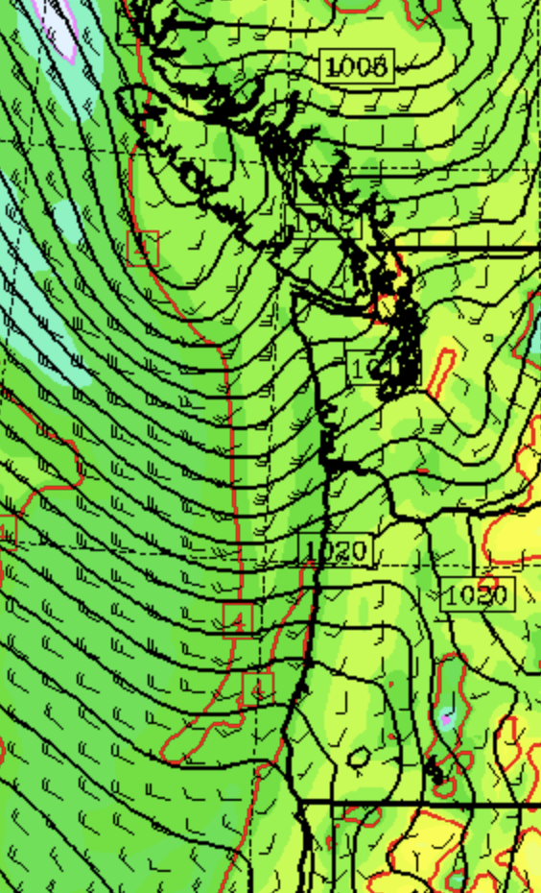
A Synoptic Meteorologist Needs to Know about the Relationships between Pressures/Heights and Winds
These relationships can vary:
  Between near the surface and aloft
  Near and away from terrain
  Between highly curved and straight flow
  When the flow is changing rapidly in time.
  By the vertical stability of the air

Slide 3
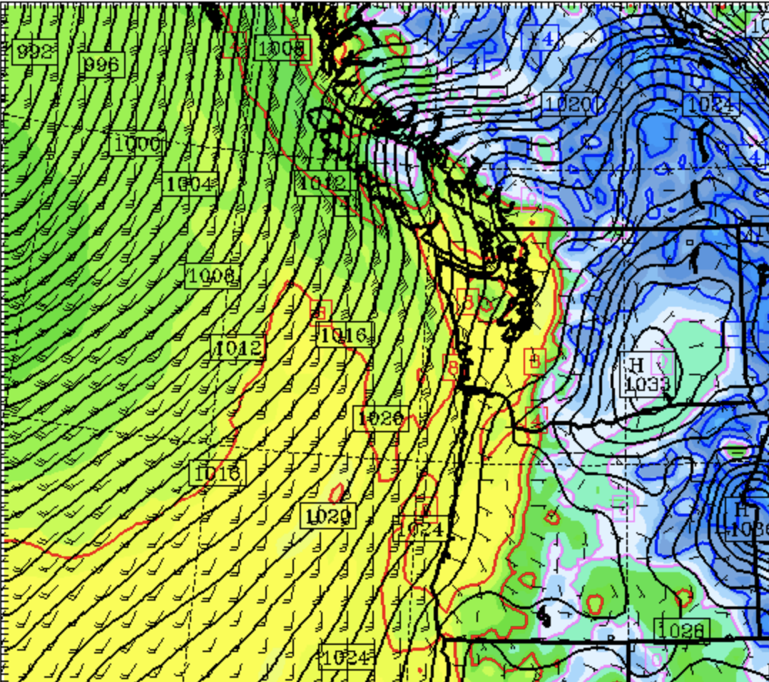
Why so valuable to know these relationships?
Very useful when you do synoptic analysis
Useful in weather prediction.

Slide 4
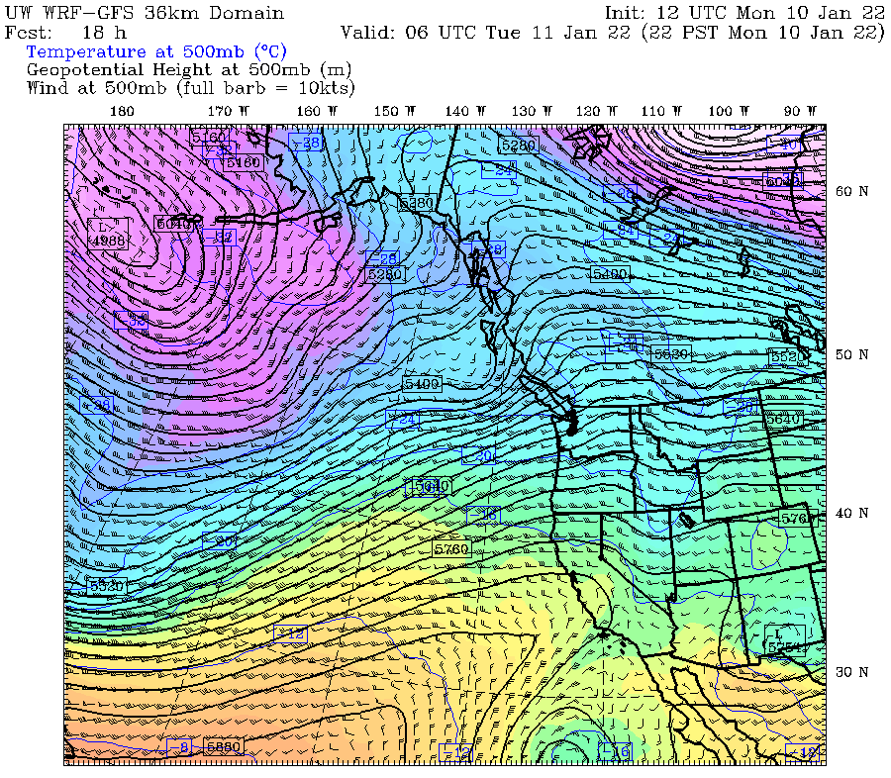
500 hPa Heights
SLP Pressure

Slide 5
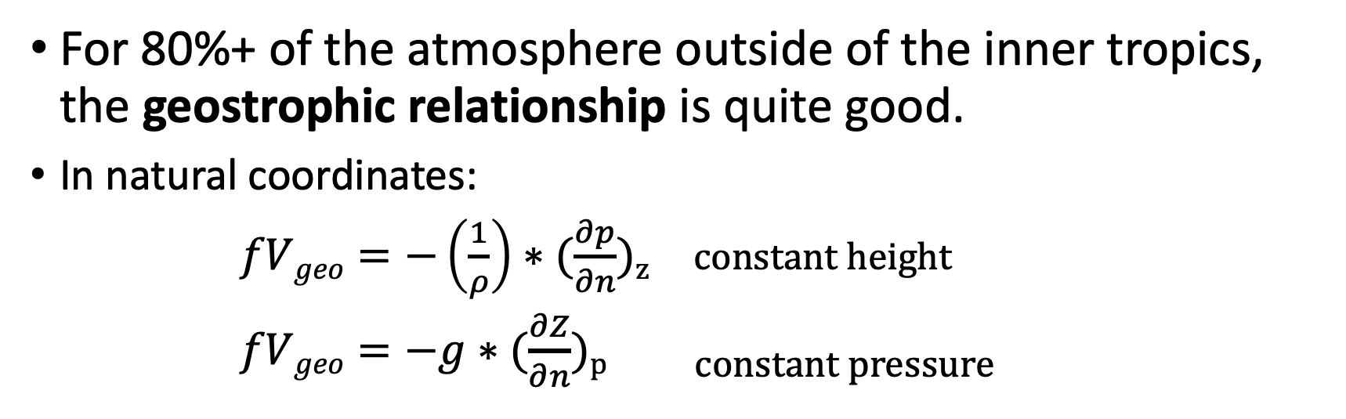


Heights and winds aloft are often closely related by the geostrophic and gradient wind relationships
For 80%+ of the atmosphere outside of the inner tropics, the geostrophic relationship is quite good.
In natural coordinates:
$fVgeo=−\left(\frac{1}{ρ}\right)∗(\frac{∂p}{∂n}$)_{z} constant height
$fVgeo=−g∗(\frac{∂Z}{∂n}$)p constant pressure
$$\vec{n}$$
$$\overset{⃑}{s}$$
Coriolis Force Horizonal Pressure Gradient Force
wind
$$f=2Ω\sin{Θ, Ω=7.292 ∗10 −5 s−1 }$$
Natural coordinates
p is pressure, z in geopotential height

Slide 6
Why is there geostrophic balance in much of the atmosphere?
?

Slide 7


Classic thought experiment
Start with a rotating planet and an atmosphere with a horizontal pressure gradient and initially no winds
Assume no surface drag or mountains to keep it simple.
north
Low
$$∇p$$
Pressure gradient
Northern
Hemisphere
As wind increases, Coriolis increases, eventually balancing pressure gradient
Air initially accelerates down the pressure gradient towards low pressure
Coriolis
$$∇p$$
No Coriolis
High
south

Slide 8
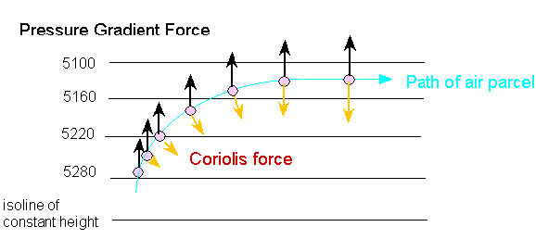
Origin of the geostrophic balance
Black arrow, pressure gradient force
Yellow arrow, Coriolis force

Slide 9
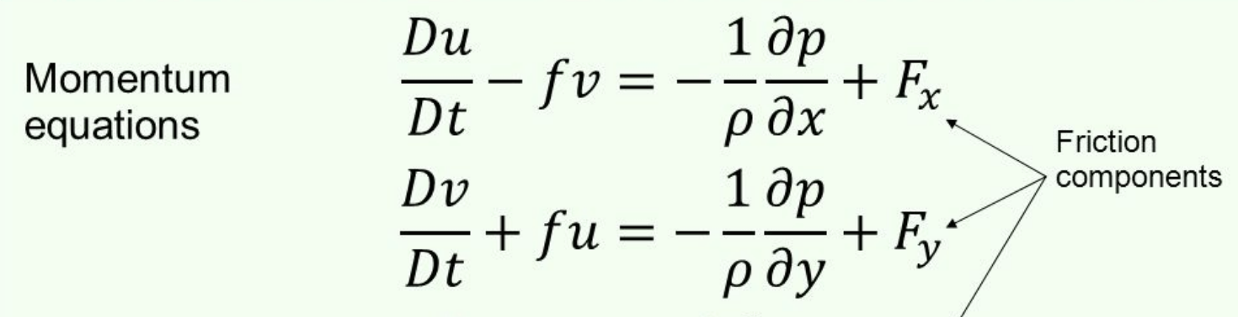
Geostrophic Balance: what you need to know
Needs sufficient space and time for the wind field to adjust to the pressure (mass) field. Coriolis takes time and space to work.
If insufficient time (say a parcel hits a mountain), no geostrophy.
Advection and time rate of change of fields must be small.
No friction.
Has to be zero

Slide 10
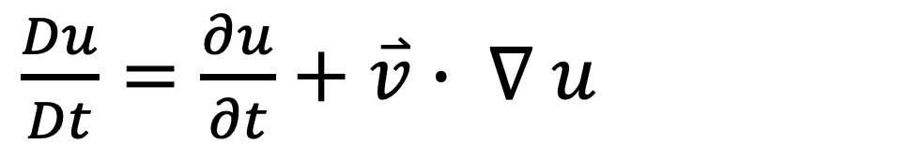
Geostrophic requires that the change of wind and advection be small
$\frac{Du}{Dt}=\frac{∂u}{∂t}+\overset{⃑}{v}$ $∙ ∇ u$
Rate of change
advection

Slide 11
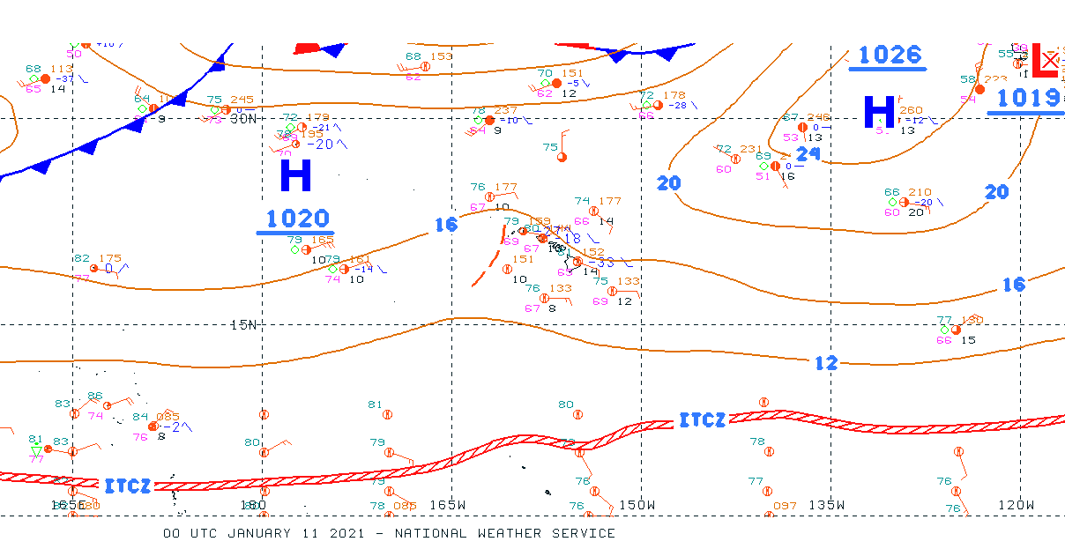
Deviations from geostrophic balance occur:
In the free atmosphere, in sharp troughs and ridges, where the centrifugal force is significant: gradient wind balance
Near the equator where f is small (Coriolis missing)
Near terrain
Near surface where drag is important
When the flow or forces change rapidly
Amazingly, geostrophic balance is applicable in a large portion of atmosphere outside of of ~5N to 5S.

Slide 12
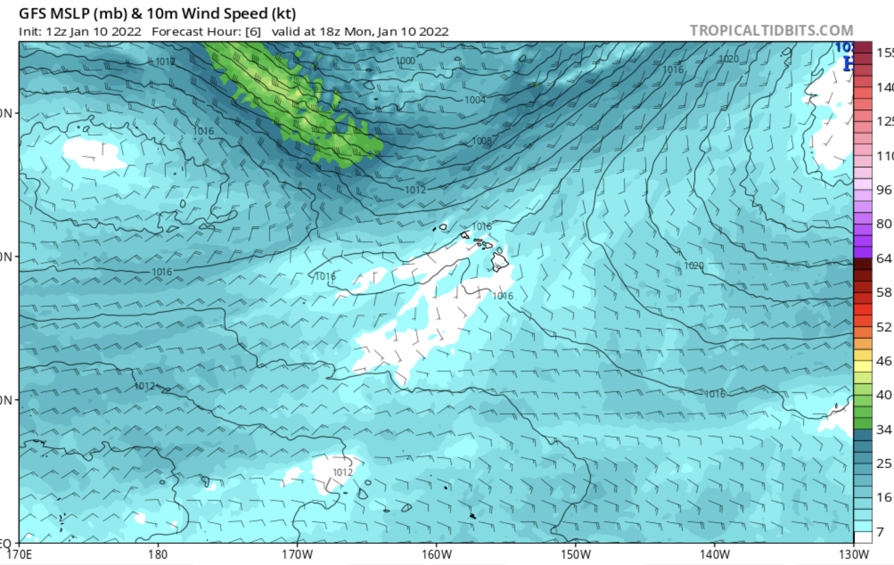
NOT GEOSTROPHIC
Equator

Slide 13
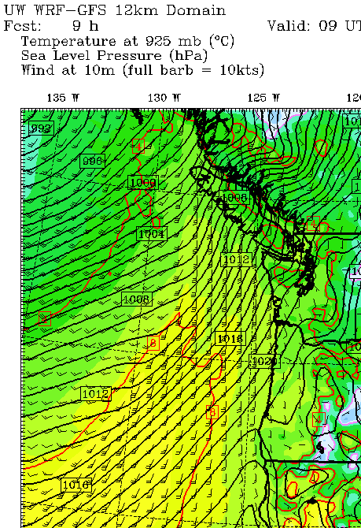
Geostrophy very good over the ocean at low levels in the midlatitudes….
Small cross isobar angle over the ocean

Slide 14
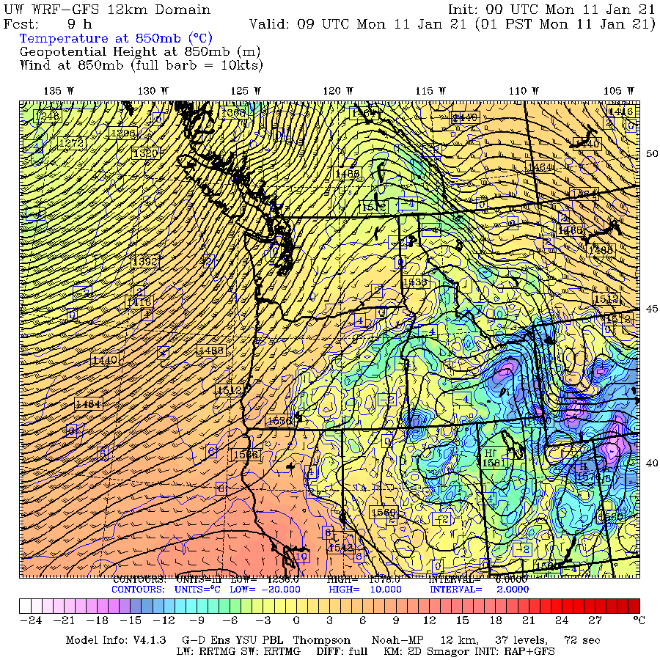
850 hPa: Close to geostrophic away from high terrain

Slide 15
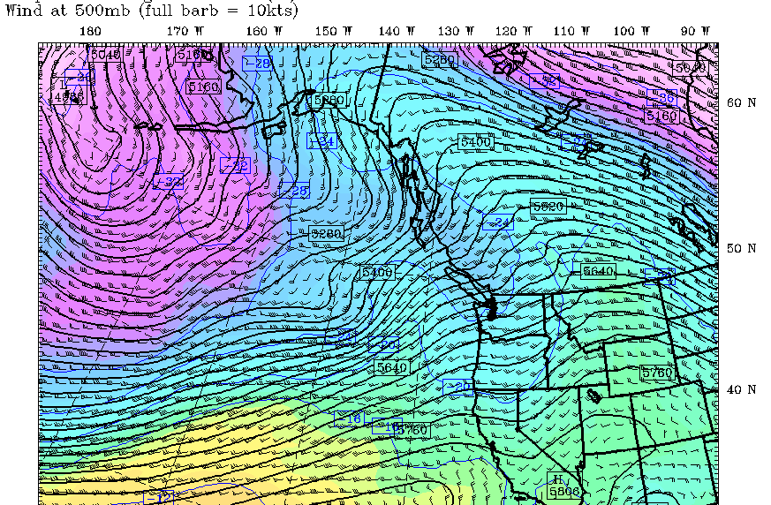
500 hPa
Very close to geostrophic

Slide 16
Can Develop a Relationship Between the Horizontal Distance Between 500 hPa Contours (60 m interval) and wind speed
L
5400
60 m
interval
V
5460
H

Slide 17
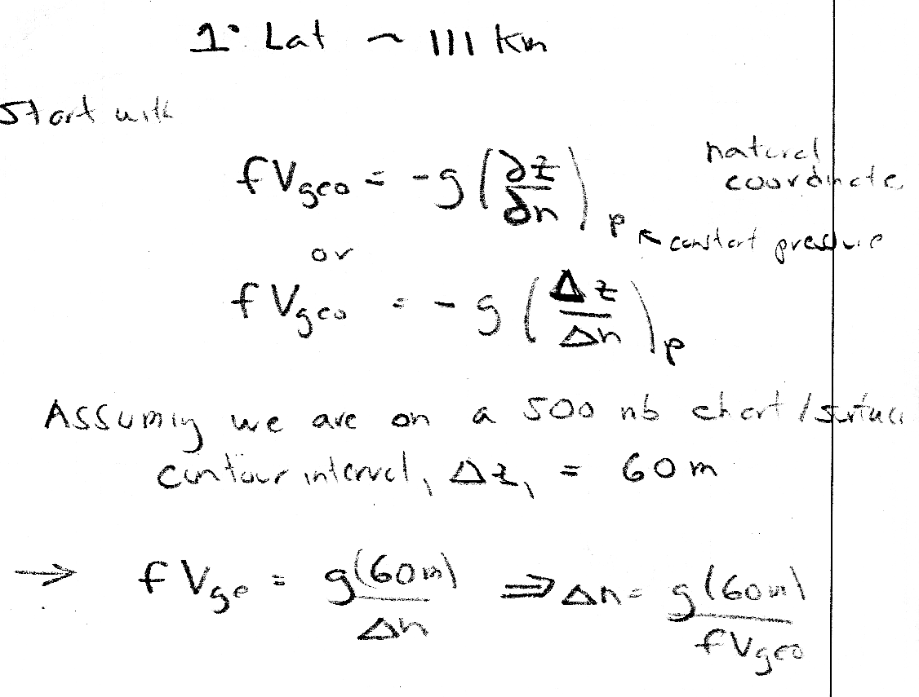

Slide 18
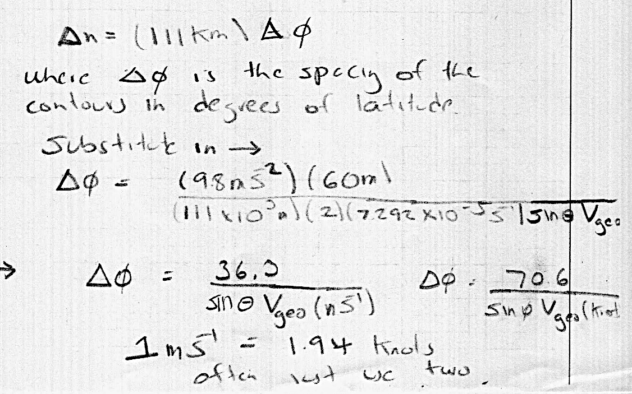
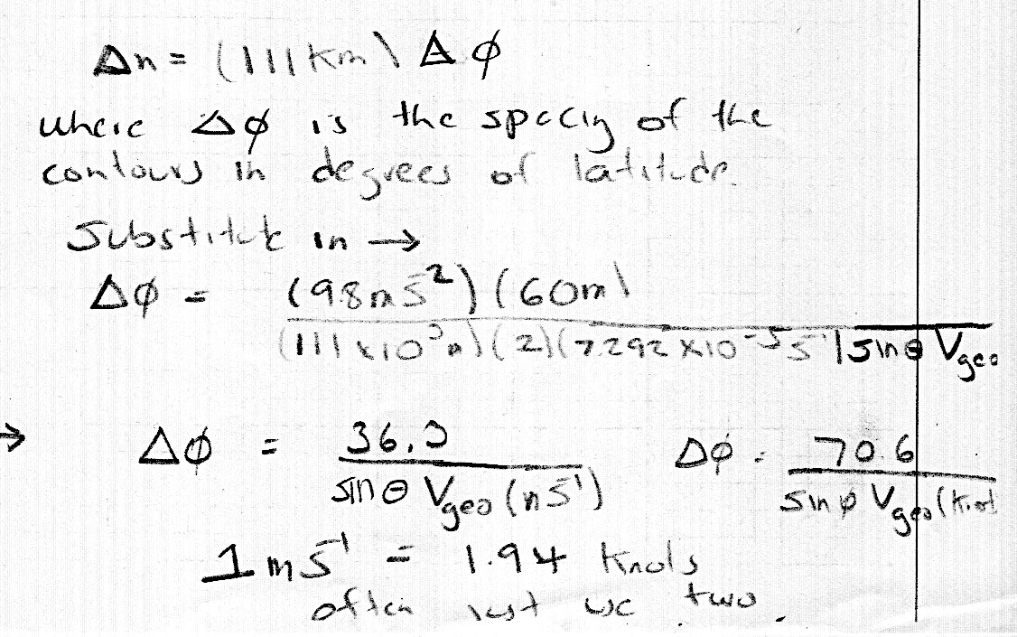

Slide 19

Low
60m
V_{g}
$$∆∅$$
High

Slide 20
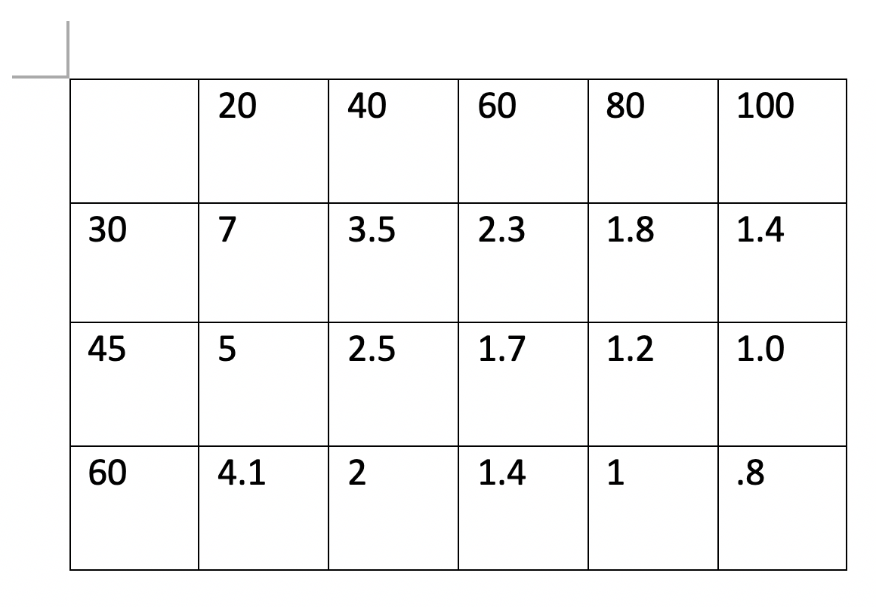
Contour Spacing (in degrees of latitude) versus Wind Speed at 500 hPa (60 m contour interval)
Wind speed in knots
1 degree of latitude
is ~ 111 km
Latitude

Slide 21
Question
Wind speed increases as contour spacing decreases.
But why does contour spacing INCREASE for the same speed as one goes to the south?
Why do we need LESS height
gradient to get the same
wind speed in the south?

Slide 22
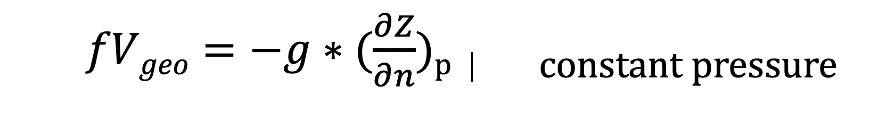
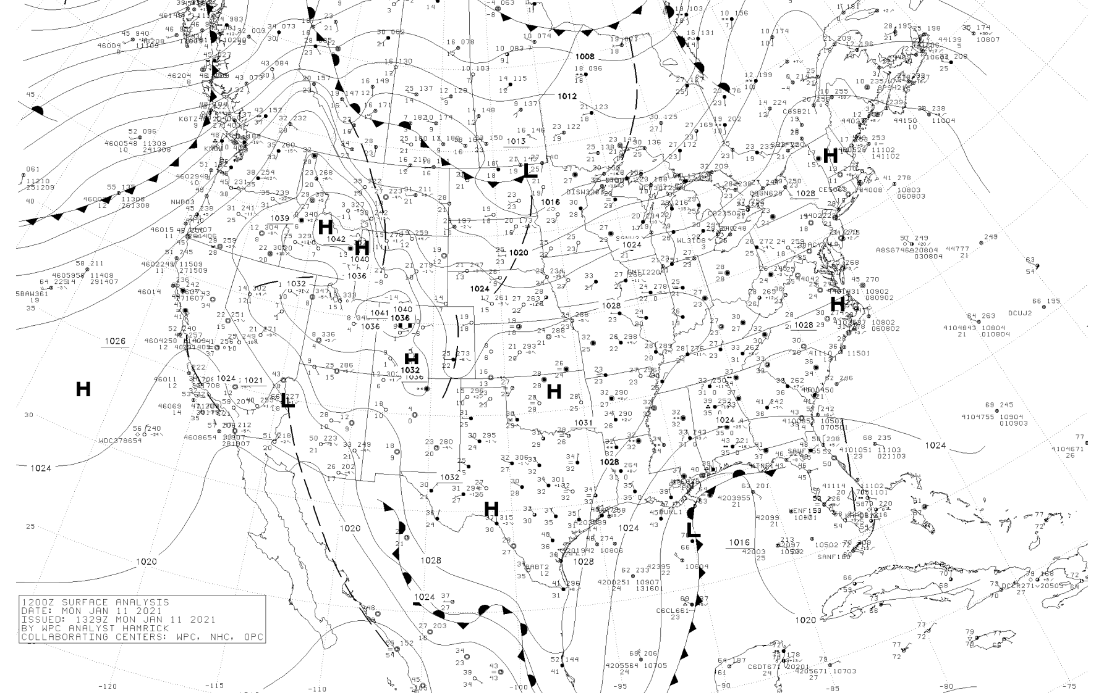
Answer: because f is less to the south.
For the same wind speed, if f is less than the gradient is less.
So less gradient for the same wind speed to the south!

Slide 23
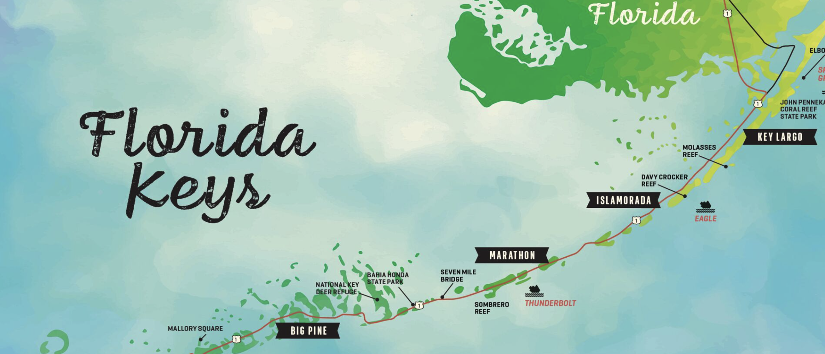
I learned this first hand on a trip to southern Florida

Slide 24
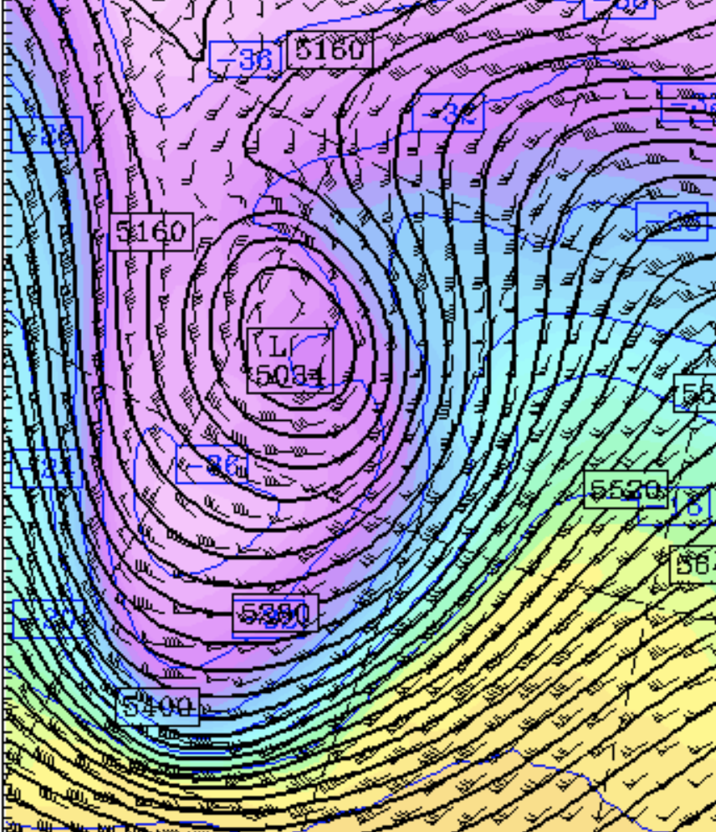
Geostrophic balance assumes that accelerations are small and that the centrifugal force is not appreciable
But in strong, sharply curved flow, the centrifugal force is important
In such situations, the gradient wind balance is more accurate.
Gradient wind balance assumes a balance between:
  Pressure gradient force
  Coriolis force
  Centrifugal force
Still assumes steady state, no drag/friction, and no mountains

Slide 25
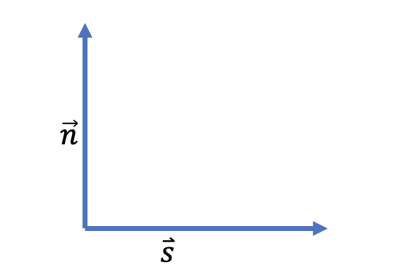
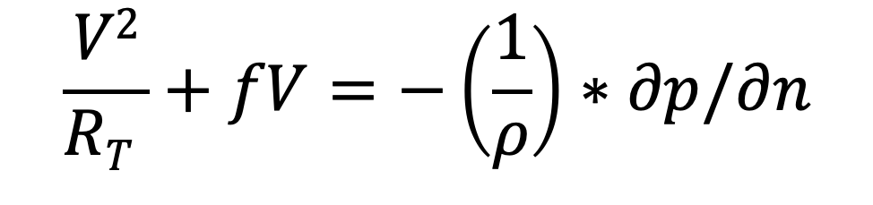
Gradient Wind Balance (natural coordinates)
$$\frac{V2}{RT }+fV=−\left(\frac{1}{ρ}\right)∗∂p/∂n$$
Centrifugal force Coriolis Pressure Gradient force
R_{T} is the radius of curvature of the trajectory through a point
V

Slide 26
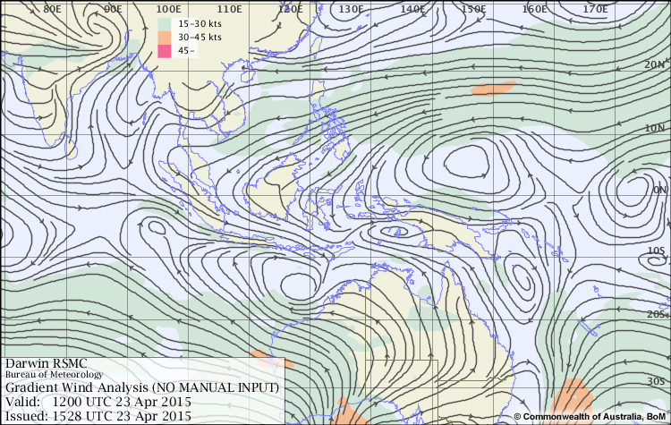
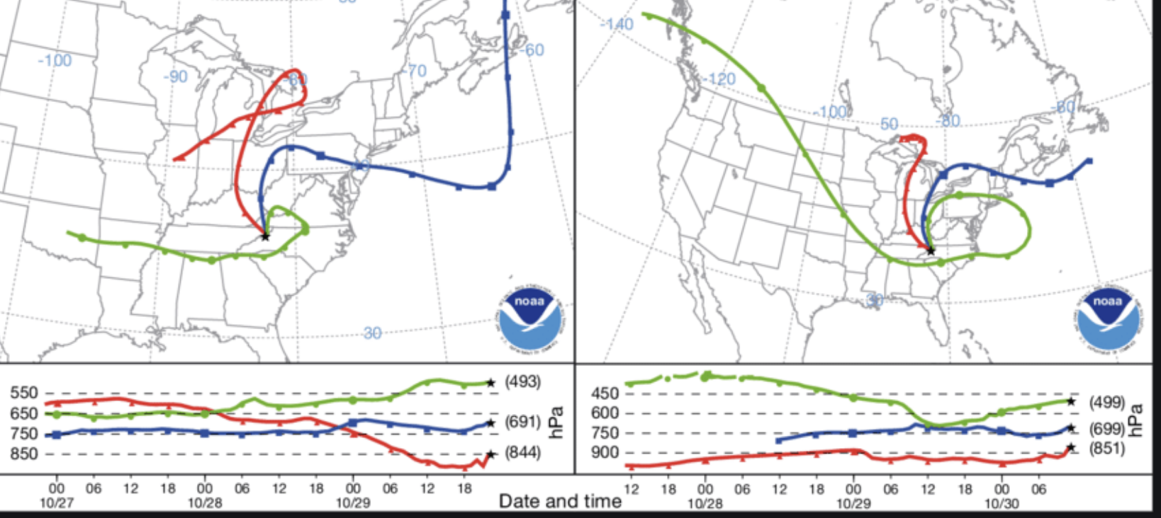
Trajectories Versus Streamlines
Streamlines are lines parallel to the flow at some time.
Trajectories show the three-dimensional path of air parcel over time ending or starting at a point.
Streamlines
Trajectories

Slide 27
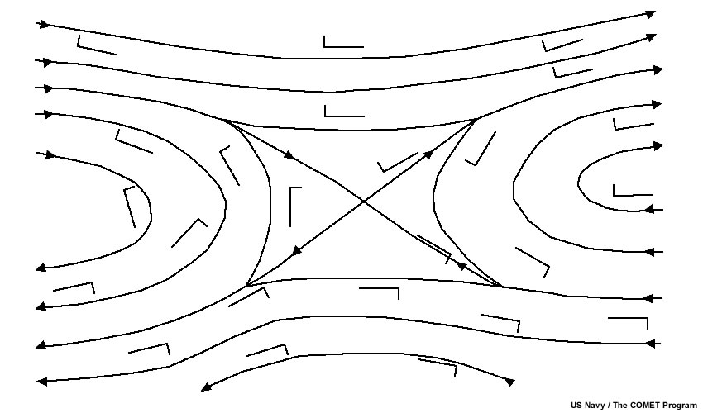
Streamlines

Slide 28
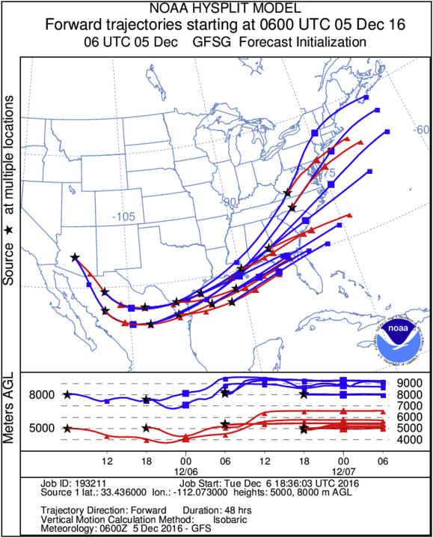
Trajectories

Slide 29
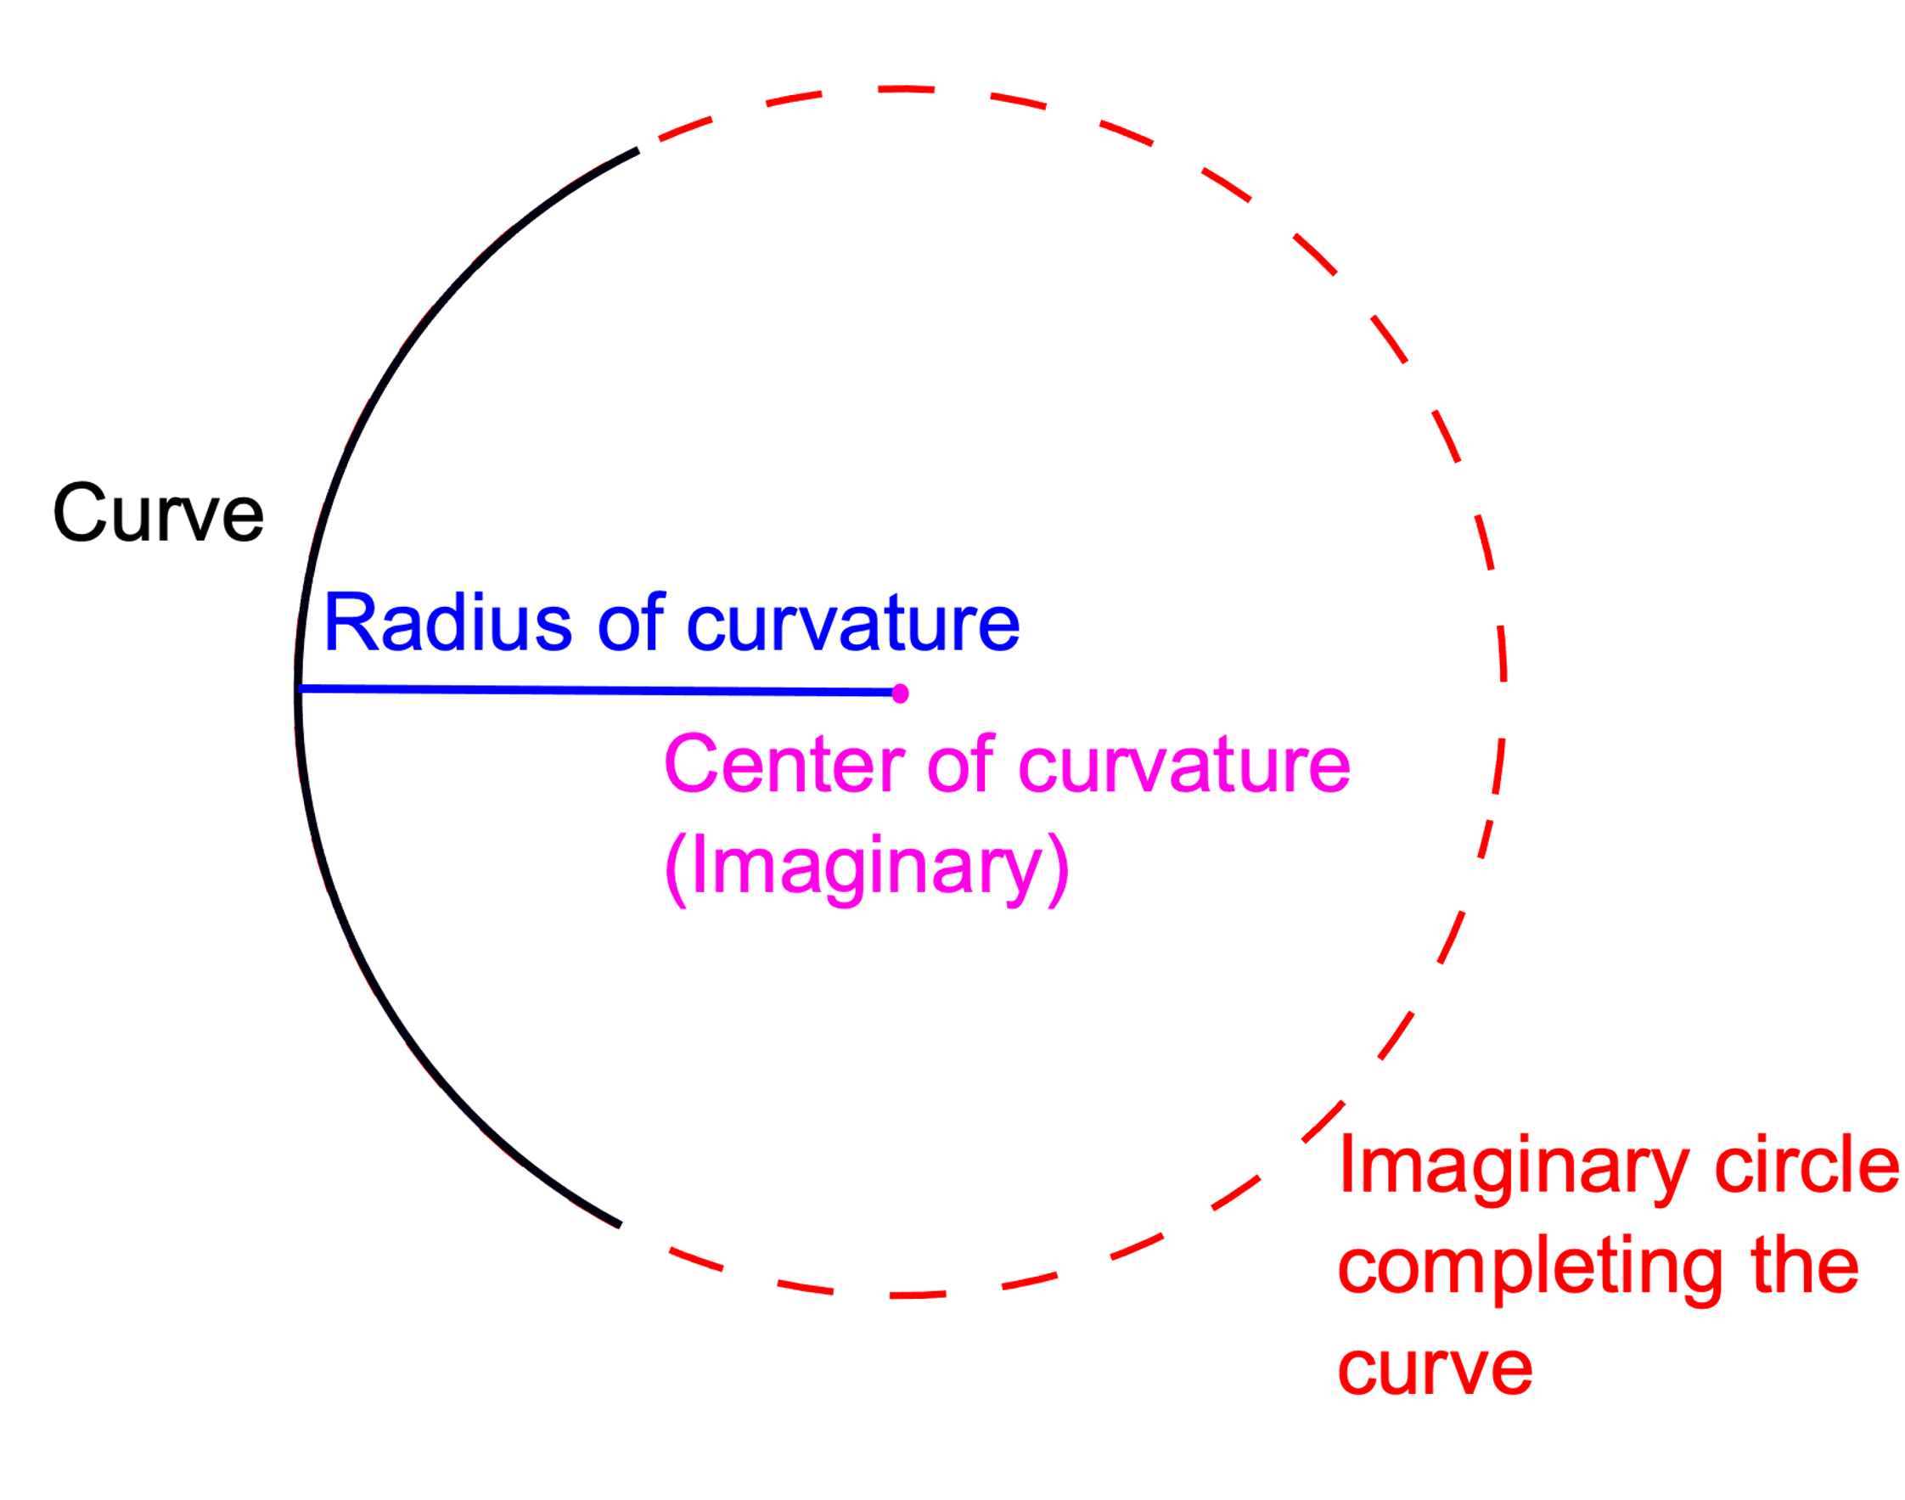
Radius of Curvature of Trajectories
trajectory
R_{T}

Slide 30
Can Understand the Qualitative Effects of the Centrifugal Force
Because Ce helps balance Pn, Co doesn’t have to be as large. Since Co= fV, then V does not have to be as large
Vgeo
Around a low or
trough
Vgrad
L
Co
P_{n}
Ce
P_{n} = Ce + Co
Thus, |Vgrad) < |Vgeo|
Wind are subgeostrophic in low and troughs
Pressure gradient force = Centrifugal force + Coriolis force

Slide 31
Opposite around Highs and Ridges
Because Ce supports P_{n}, Co has to be larger. Since Co= fV, then V needs to be larger
Around a high or
ridge
H
Ce
Co
P_{n}
Vgeo
Vgrad
P_{n} + Ce = Co
Thus, |Vgrad) > |Vgeo|
Wind are supergeostrophic in highs and ridges
Pressure gradient force = Centrifugal force + Coriolis force

Slide 32
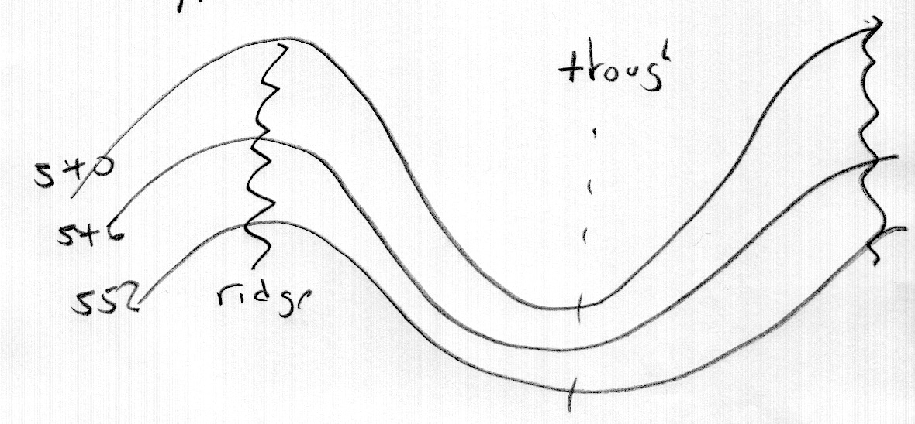
Explains an Interesting Phenomenon
Similar wind speeds with different gradients
Similar wind speed
Similar wind speed
supergeostrophic
subgeostrophic

Slide 33
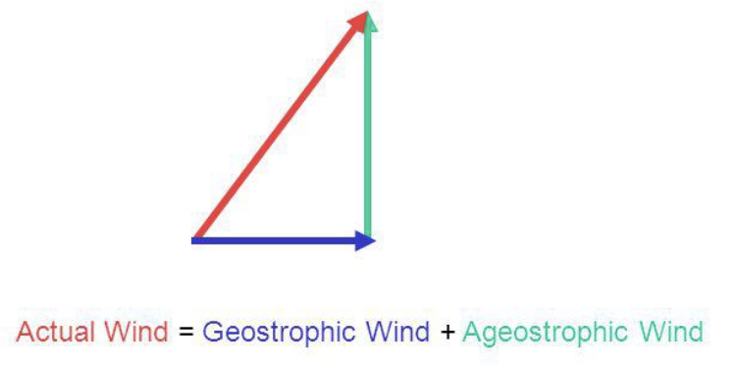
Observed wind speeds in sharp troughs with high winds can be as much as 50% subgeostrophic, although most troughs are less.
Next, I will show you a series of maps with heights, plus the ageostrophic wind vector.
The ageostrophic wind vector is the vector difference between the actual wind and the geostrophic wind
Actual Wind
Geostrophic Wind
Ageostrophic Win

Slide 34
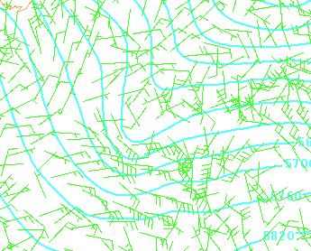
If ageostrophic wind vector is going in the opposite direction of the wind, then winds are less than geostrophic: subgeostrophic
Heights and ageostrophic winds at 500 hPa

Slide 35
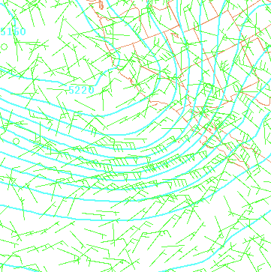
Another subgeostrophic example

Slide 36
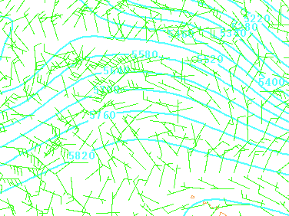
Supergeostrophic in ridge

Slide 37
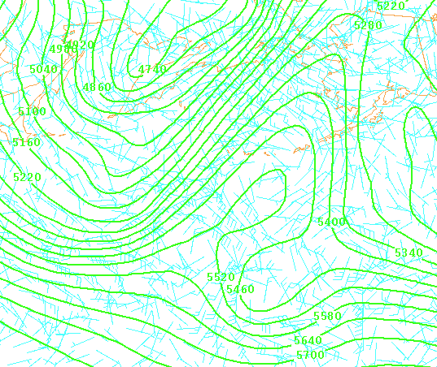

Slide 38
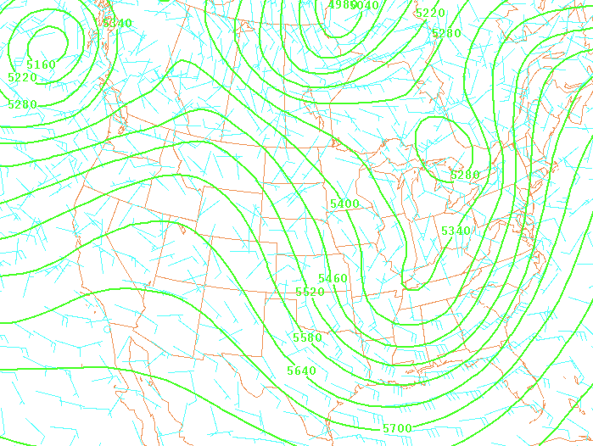

Slide 39
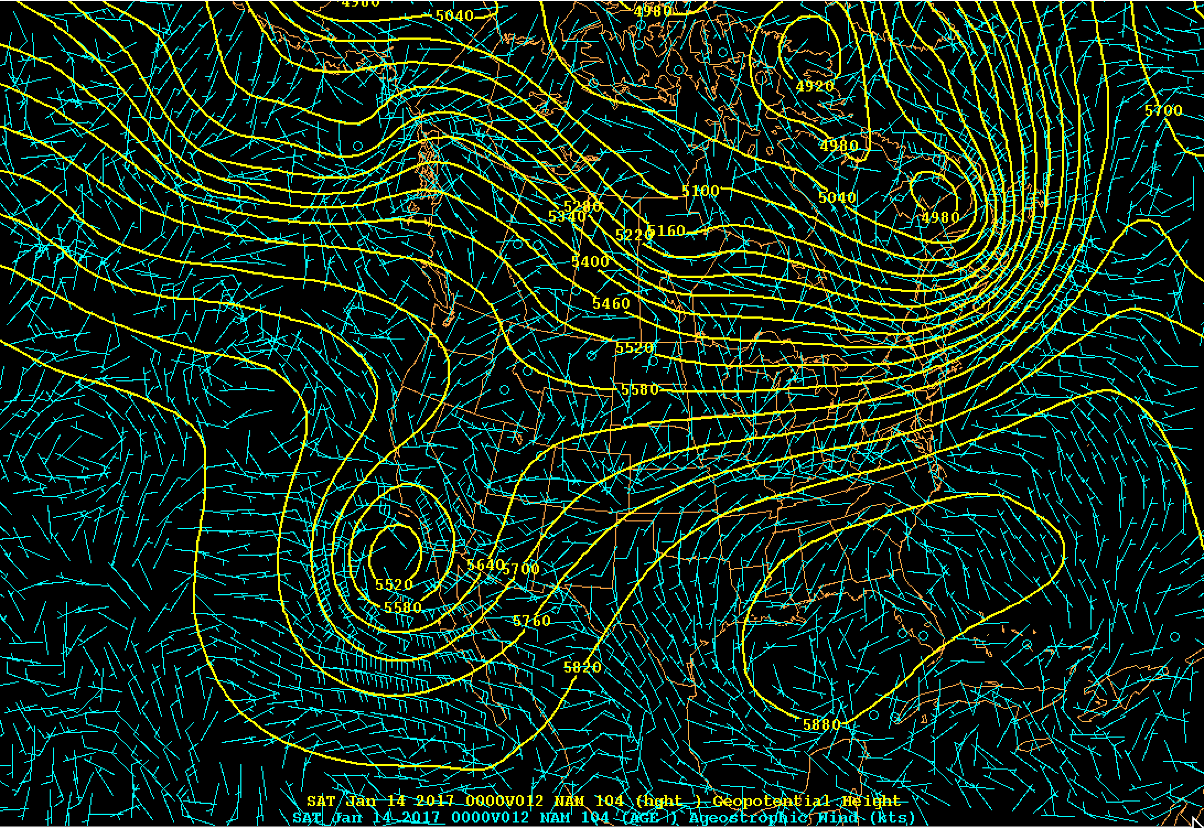

Slide 40
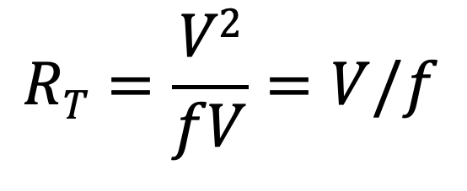
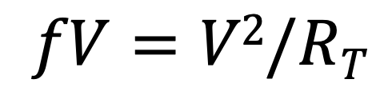
Inertial Wind Balance
Coriolis Force Balanced by Centrifugal force in an environment where pressure gradient is absent
$fV=V2/RT$
Coriolis Centrifugal
$$RT=\frac{V2}{fV}=V/f$$
Thus, one ends up with curved trajectories, whose radius of curvature depends on wind speed and latitude

Slide 41
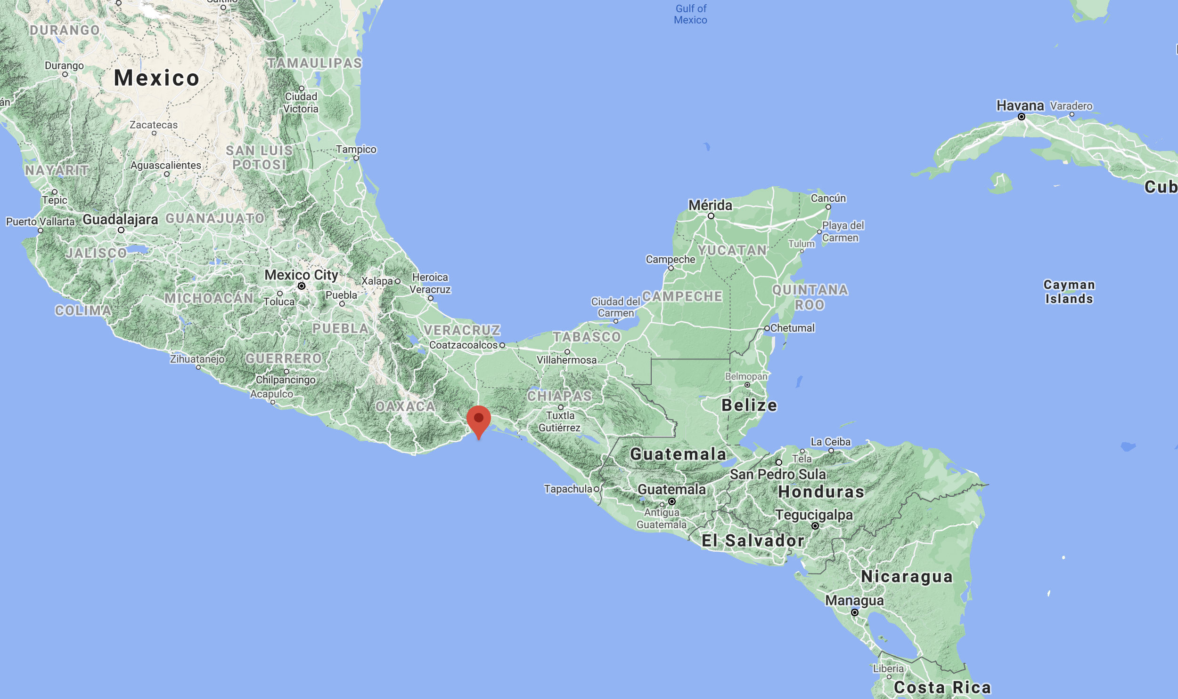
Inertial Wind (IW) Balance
Can be evident when flow escapes from a gap into the open ocean in the form of jet of strong winds
IW balance is only strictly followed at the center of the flow exiting the gap (there is often a pressure gradient on the side of the jet)
Great example: The Gulf of Tehuantepec

Slide 42
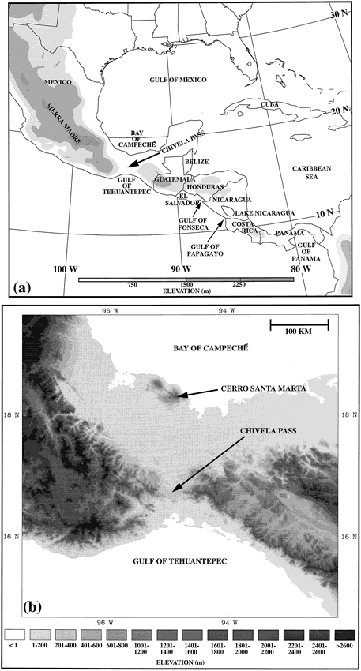
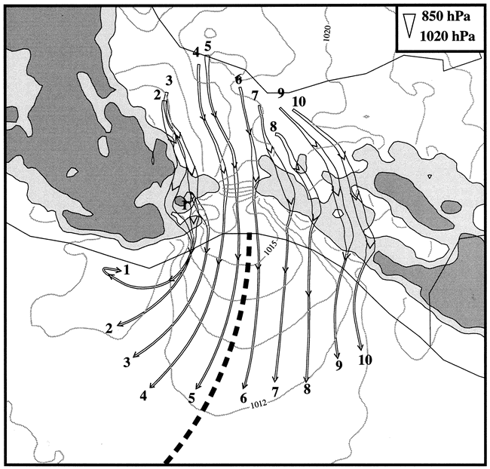

Slide 43
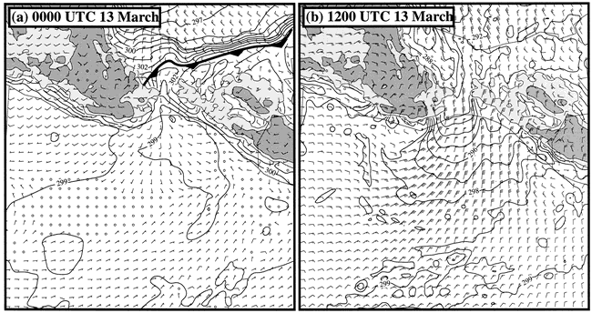
Model Simulation

Slide 44
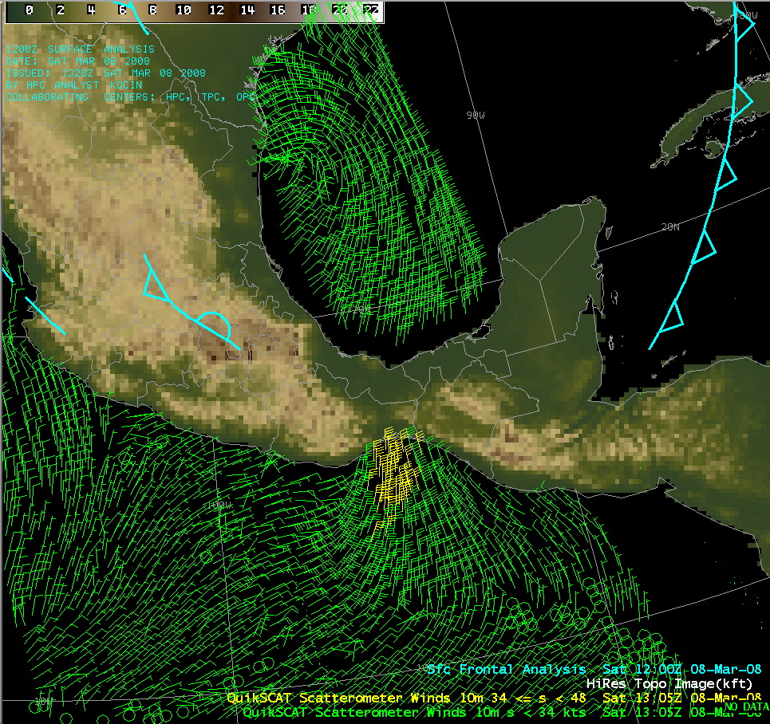
Observations
Scatterometer
Winds

Slide 45
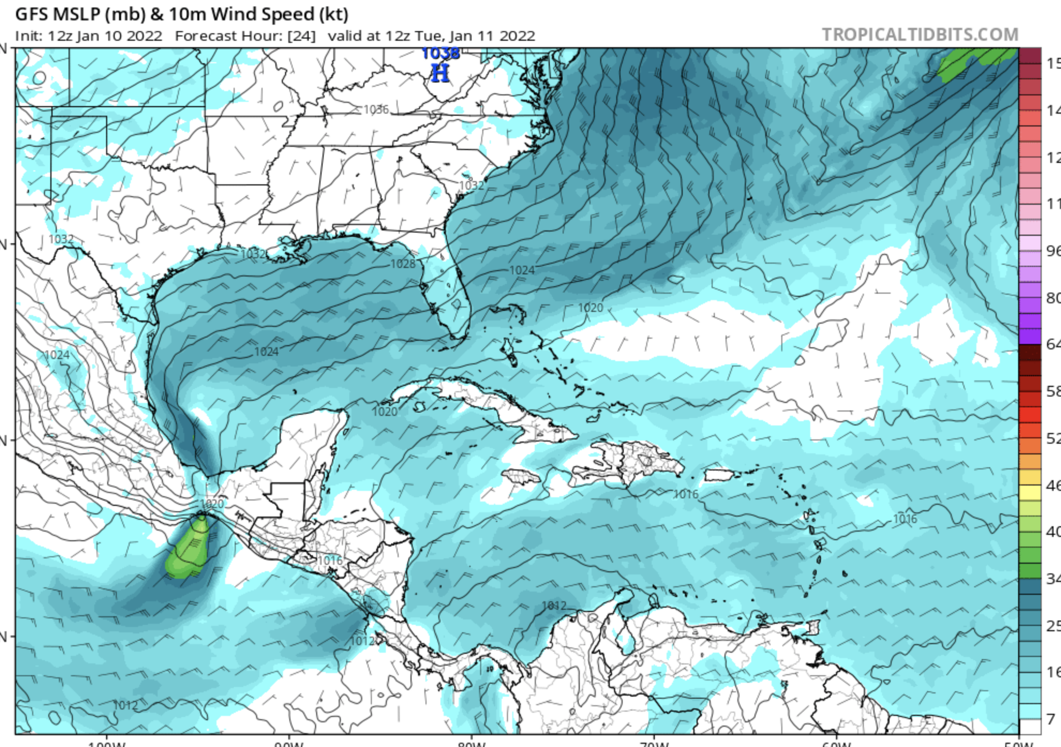
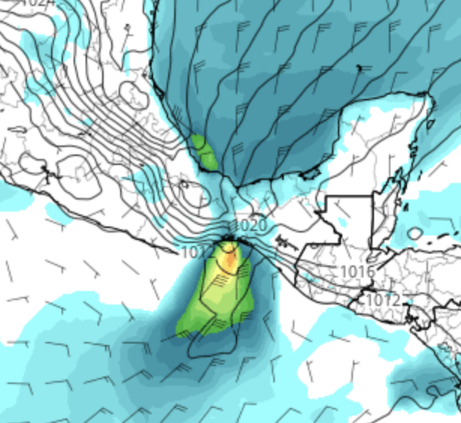
Recent Example

Slide 46
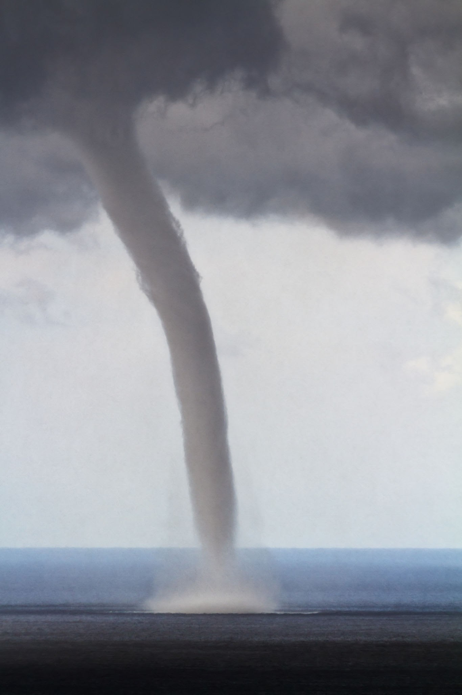
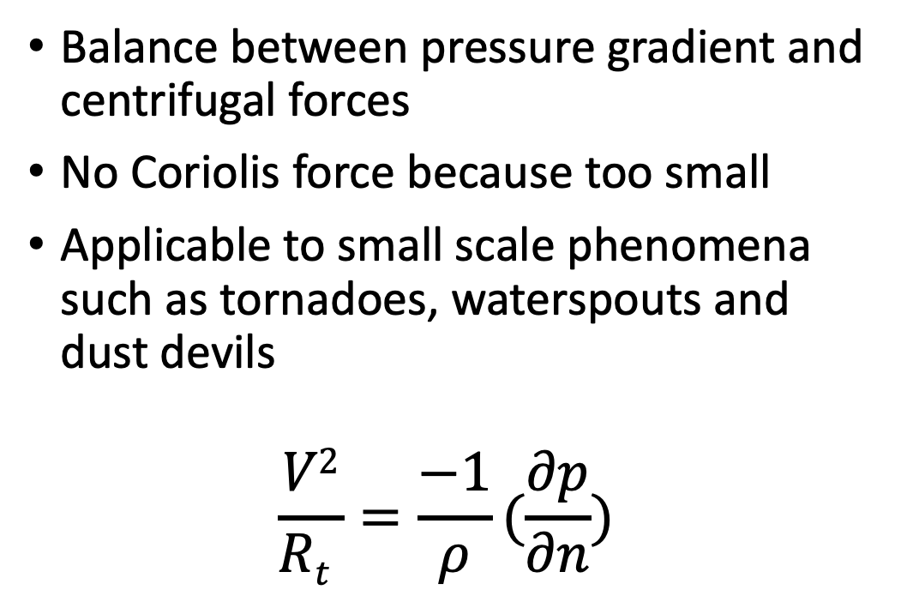
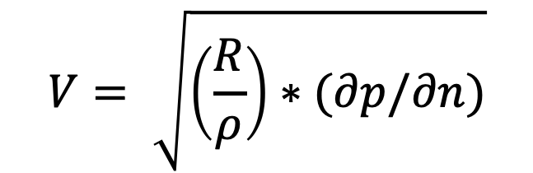
Cyclostrophic Balance
Balance between pressure gradient and centrifugal forces
No Coriolis force because too small
Applicable to small scale phenomena such as tornadoes, waterspouts and dust devils
$$\frac{V2}{Rt }=\frac{−1}{ρ}(\frac{∂p}{∂n})$$
Centrifugal Pressure Gradient
$$V= \sqrt{\left(\frac{R}{ρ}\right)∗(∂p/∂n)}$$

Slide 47

Surface drag or friction at the surface can result in a three-way force balance
Pressure gradient force
Coriolis force
Friction or drag
Reduces wind speed from geostrophic
Creates a component of wind towards lower pressure.
Low pressure
p
V
$$∅$$
Cross isobar angle
Vgeo
p +Δp
High pressure

Slide 48
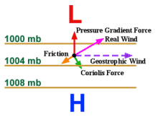
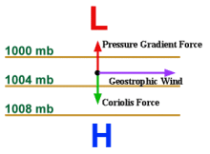
Three-way balance
Drag
No drag
Typically, drag causes 20-30 degree cross isobar angle and 20-30% reduction in speed over relatively flat land
Rougher surface and more stable in vertical gives lower speeds and more cross isobar angle. Why?

Slide 49
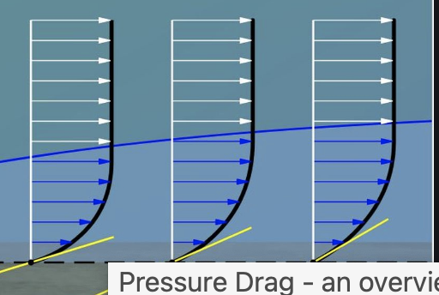
Varying drag effects on surface winds
A rougher surface obviously produces more drag
Less stability mean more mixing in the vertical, which mixes down faster air from aloft that is not in contact with the rough surface.
More stability means the effects of drag are concentrated in a shallow air layer near the surface. Slower winds.

Slide 50
V/V_{g} (no terrain) and cross isobar angle as stability changes.
Unstable: V/V_{g} ~ .8-.95,
φ ~ 5-15°
Neutral: V/V_{g}~.75,
φ ~ 25°
Stable: V/V_{g}~..5-75,
φ = 30+°

Slide 51

Surface Winds: Water Versus Land
Drag over water is low so V/V_{g} is higher
Nearly geostrophic over water when low stability (e.g., behind Pacific front): V/V_{g}~ .95, φ ~ 5-10°

Slide 52
More Geostrophic
Conditions
Less
Geostrophic

Slide 53

Water is aerodynamically smooth
Winds are often 50% to 300% stronger over water than land for same pressure gradients.
Only takes a few km of overwater conditions to facilitate a speed up

Slide 54


Slide 55


Slide 56


Slide 58

More
geostrophic
Less
geostrophic

Slide 59

Wind Increases Rapidly With Height, Since Drag/Friction is Greatest at the Surface.
Thus, winds become more geostrophic with height

Slide 60

Winds Vary During the Day As Stability Changes
Stronger during the daytime, particularly over land
Weaker at night
Reason: atmosphere is less stable during day, tends to mix stronger momentum down to surface.

Slide 61

Orographic (terrain) barriers can alter the pressure and wind fields
Winds near terrain tend to be highly ageostrophic (not geostrophic), with a tendency to blow from high to low pressure
Near terrain, winds tend to flow down the alongbarrier pressure gradient, with downgradient acceleration eventually being balanced by surface drag.
alongbarrier

Slide 62

Schematic
Assuming no friction
Stable conditions
R—the distance from terrain of mountain influence-- is typically ~150 km
Near terrain, the adjustment of the winds to pressure field is interrupted, not enough time for Coriolis force to act to balance pressure gradient force.
NOT GEOSTROPHIC
GEOSTROPHIC

Slide 63
Force Balance Near Terrain
Near terrain, air tends to flow downgradient (towards lower pressure), down the along-barrier pressure gradient from high to low pressure.
Low
North
1000 hPa
1004
Alongbarrier
Pressure
Gradient
1008
wind
1012
South
HIgh

Slide 64

Near terrain there is a three-way balance
Between:
  Acceleration
  Pressure Gradient Force
  Drag/Friction

Slide 65


Near terrain there is a three-way force balance
Considering just the north-south component (v), the balance is between:
  Acceleration, dv/dt
  Pressure gradient force, ($−1/ρ)∗∂p/∂y$
  Friction/drag, often parameterized by C_{d}v², where C_{d} is a drag coefficient

Slide 66
Balances Near Terrain
Initially, acceleration along the barrier is large and friction/drag is small (since Fr ~C_{d}v²)
As wind speed increases, friction/drag increases rapidly (since Fr ~C_{d}v²)
Eventually, there is balance between the pressure gradient force and drag/friction. And acceleration goes to zero
This is called the antitriptic balance.

Slide 67

Real Life Example

Slide 68


Slide 69

Without the Coriolis force balancing the pressure gradient, winds near terrain can be STRONGER than geostrophic!

Slide 70

Interesting Application for Local Windstorms
Which situation give you the strongest winds at SeaTac Airport?
A or B?

Slide 71
The ANSWER IS B.
Why?
Because there is a larger alongbarrier pressure gradient in B with a wind balance that is NOT geostrophic.

Slide 72


Slide 73


Slide 74

Found around the world, where there is stable flow interacting with terrain.
Associated with a semi-geostrophic balance. Geostrophic in one direction and ageostrophic in another.

Slide 75

Cold air damming---a pressure ridge east of the Appalachians associated with cold air

Slide 76


Slide 77

High

Slide 78

LOWER
HIGHER
Low
Pressure
High Pressure

Slide 79

Semi-geostrophic balance
High
Low

Slide 80

Winds are generally very non-geostrophic in gaps in terrain
Winds tend to blow down the gaps from high to low pressure
Winds are generally strongest at the exits of the gaps, not in the middle.

Slide 81



Slide 83
end

